Slide 1

Current Airline Safety
Gabriel Valenzuela

Slide 2
Agenda
Present Atmosphere around Air Travel
Current and Past Statistics
Economic Obstacles
Re-construct the image
Questions

Slide 3
Current Atmosphere
Due to the recent unfortunate airline crashes:
The media is reporting:
Air travel is no longer safe
Most dangerous way to travel
Driving fear into customers all over

Slide 4
What are the actual statistics around air travel?

Slide 5
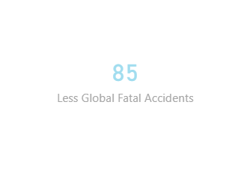
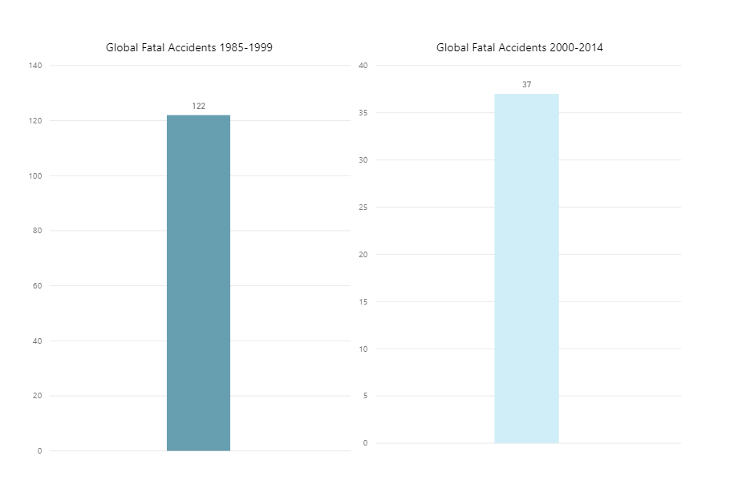
Global Statistics of Fatal Accidents (1985 – 2014)
Decrease in global fatal accidents
Across 56 different airlines
Data Reference: Aviation Safety Network – Safety Record

Slide 6
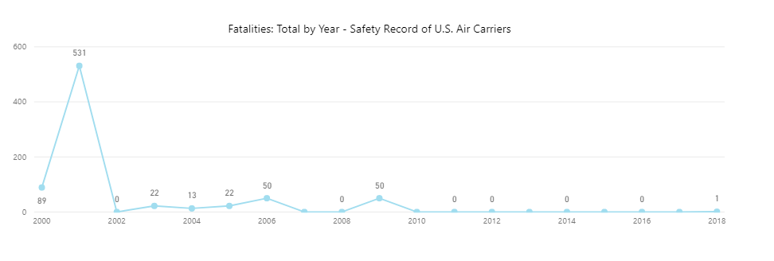
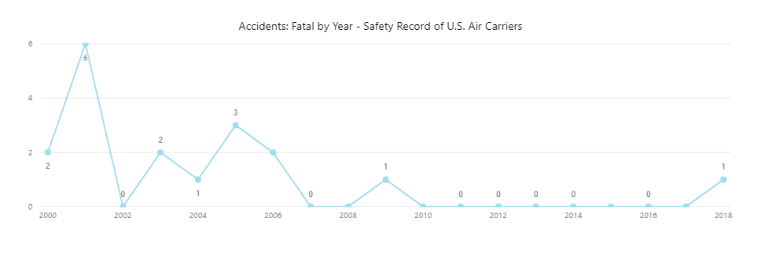
U.S. Statistics of Accidents and Fatalities
For the last 20 years:
Accidents have not gone over 10
Fatalities have not gone over 100
Aside from the events that occurred on 9/11
The amount of fatalities and accidents have decreased to zero in various years
Safety priority has held these values so low
Data Source: Airlines for America – Safety Record

Slide 7
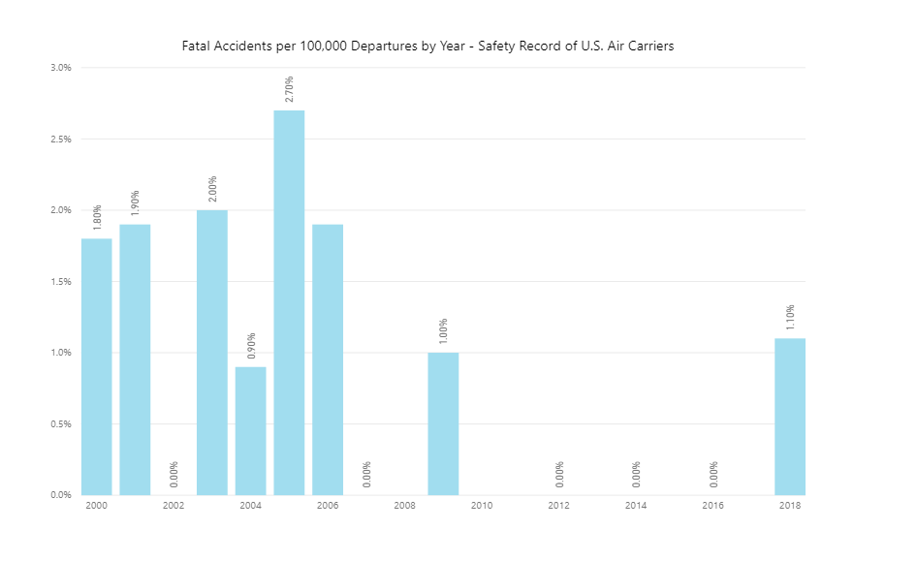
Accidents per 100,000 Departures
For every 100,000 flights:
Last twenty years
Less than 3%
Certain years reporting less than a 1% chance for every 100,000 flights
The likelihood of an air travel accident are very low
Data Source: Airlines for America – Safety Record

Slide 8
Outside of safety, what are other issues facing air travel such as economic?

Slide 9
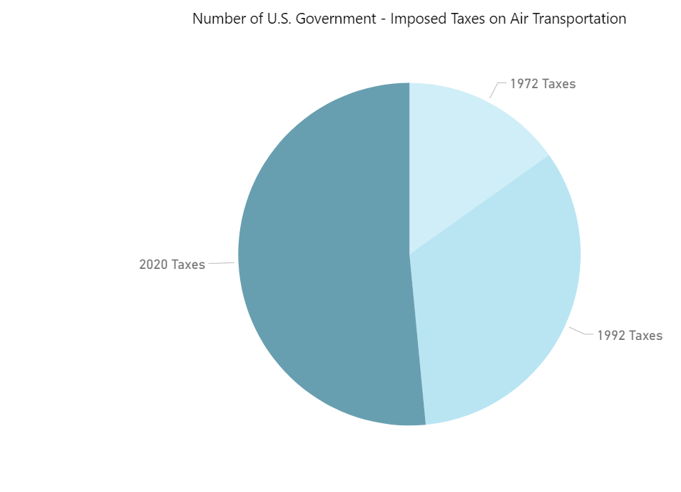
Economic Obstacles & Predictions
Since 1972
Taxes have continued to rise
Every 20-25 years
Six taxes have been added to the total
Possibly by 2045
23 different taxes on air travel
Increasing the cost of flights
Data Source: Airlines for America - Taxes

Slide 10

Re-Constructing the Image
Airline travel has seen an improvement in air safety within the last 20 years
It is not only safer in the U.S. but globally
For every 100,000 departures, there is a 0.1% to 1.5% chance of an accident occurring
In the U.S. alone, there has been less than 20 reported accidents in last 10 years compared to the high amounts of reported car accidents within the last ten years.

Slide 11
Data References
Aviation Safety Network
https://aviation-safety.net/
Airlines for America – Safety Record
https://www.airlines.org/dataset/safety-record-of-u-s-air-carriers/#
Airlines for America – Taxes
https://www.airlines.org/dataset/government-imposed-taxes-on-air-transportation/#

Slide 12
Questions?

